Slide 1
xFx Un framework para dominarlos a todos
Notes:
Intro: 5 mins till Demo 1
Live demo: about 22 mins

Slide 2
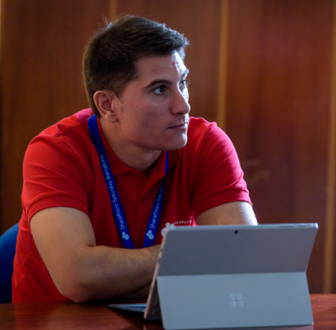
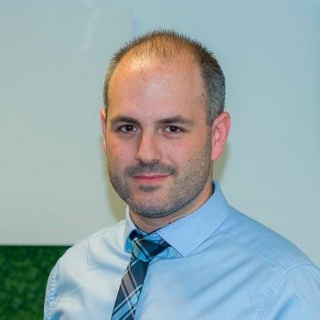
Luis mañez
Angel David carrillo
Cloud Architect
Office 365 Team lead
ClearPeople LTD
Raona
@luismanez
@angeidav
https://www.linkedin.com/in/luismanez/
https://www.linkedin.com/in/angeldavidcarrillo/
Office Development MVP. More than 15 years of experience working with Microsoft Technologies. MS Certified specialist in Developing Azure and SharePoint MCPD. Passionate about technology, blogger, technical writer and MS community active member.
Director de proyectos, líder de equipo y arquitecto con 9 años de experiencia especializado en aplicaciones Microsoft y plataforma SharePoint y Office 365, donde está reconocido como Profesional Microsoft (MCP) al estar certificado oficialmente como "Microsoft Specialist" y "Microsoft Certified Solutions Developer (MCSD): App Builder, Web Applications y Sharepoint Applications" como miembro Charter.

Slide 3
Wifi Key for attendees
Connect to the wireless network MSFTGUEST
Open a browser and navigate to a web site to be redirected to the Captive Portal
Click on Event Attendee Code and enter the access code: msevent424zq

Slide 4
https://github.com/CompartiMOSS/SPS-Office-365-Saturday-Madrid-2019-WorkShop/tree/master/spfx-teams-graph

Slide 5
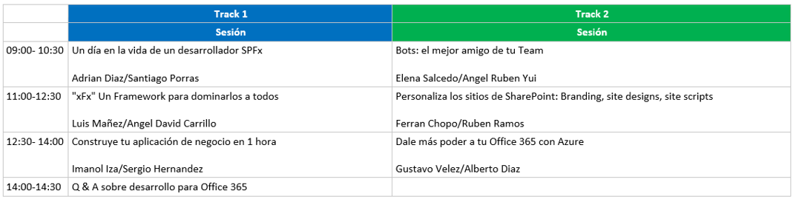
Agenda

